Slide 1
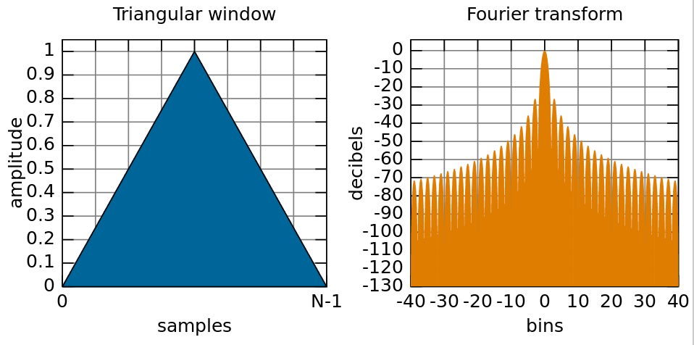
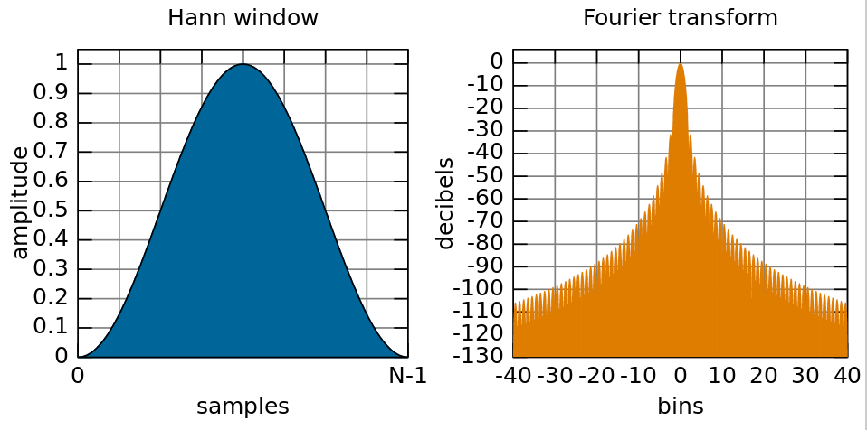
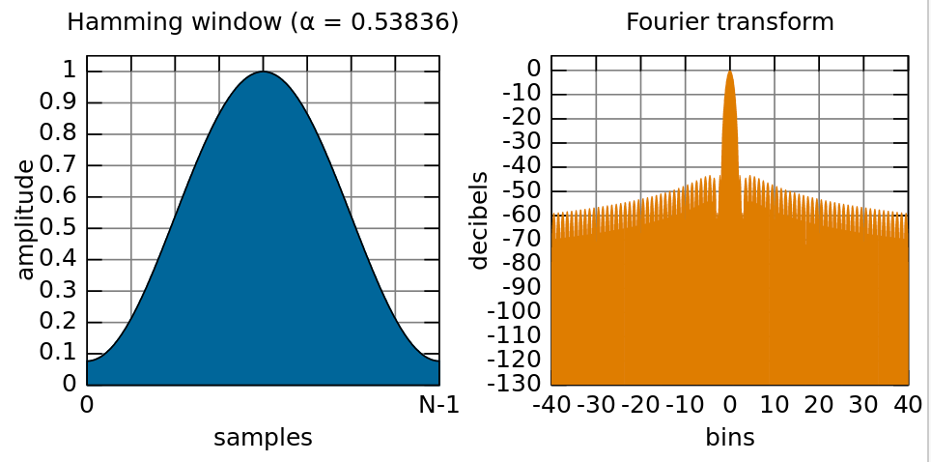
Phase vocoder, part 2
Look more at working in frequency domain
Window functions: why and how
Constant Overlap-Add (COLA) criterion
Analysis and synthesis windows
Reconstructing exact frequency from FFT bin phase
Phase vocoder effects:
FFT-based frequency detector
Robotisation (phase zeroing)
Whisperisation (phase randomisation)
Pitch shifting
[images: wikipedia]

Slide 2
Sine wave in the frequency domain: task
Task: run the example project fft-sine
This project takes FFT of a sine wave and displays the spectrum in the GUI
Block-based processing in render.cpp
Adjust the frequency of the oscillator in the GUI: what happens to the spectrum?
By default, the sine is exactly on an FFT bin frequency
After you adjust it, the frequency will fall between FFT bins
You can change the FFT size at the top of render.cpp

Slide 3
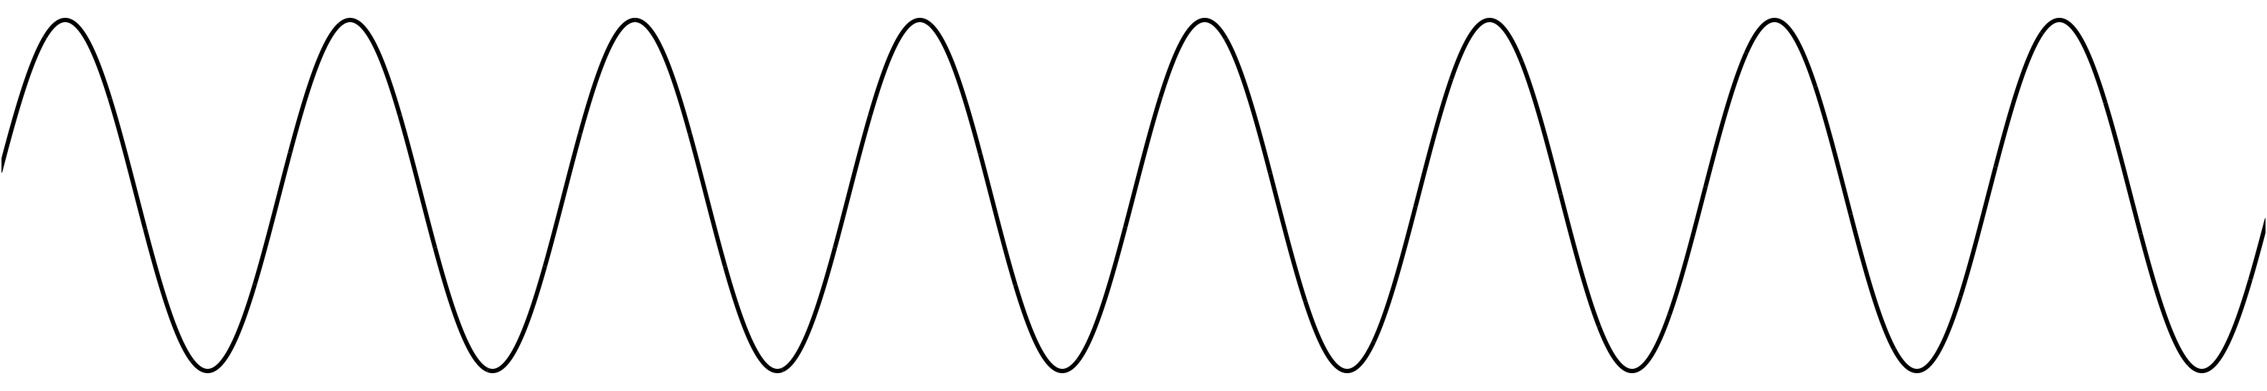
Sine wave in the frequency domain
What does the FFT of a single sine wave look like?
Let’s suppose its frequency exactly matches a bin: 2πk/N for some k
This means that an integer number of oscillations fit in the window
...
x[n]
All energy is in one frequency bin
All other bins 0 (except mirror image above Nyquist)
Magnitude is constant no matter where the window starts
Phase may change depending on window location
Xk
(lower half)

Slide 4
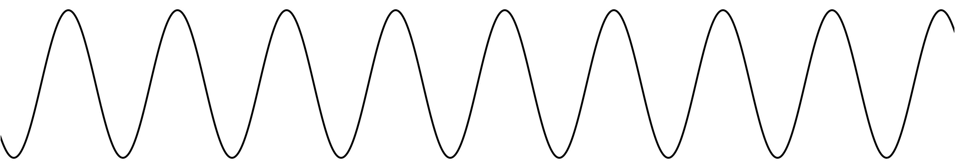
Sine wave in the frequency domain
What if frequency doesn’t exactly match any bin? We’ll see two effects:
Energy smears out across all the other frequency bins (we’ll see why shortly)
Phase is likely to be different on each successive hop
If we’re clever, we can reconstruct the exact frequency based on the phase changes!
x[n]
Non-integer number
of periods
Xk
Energy spills over into
other bins, especially close neighbours
(lower half)

Slide 5
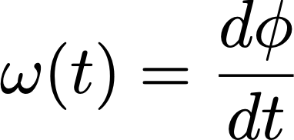
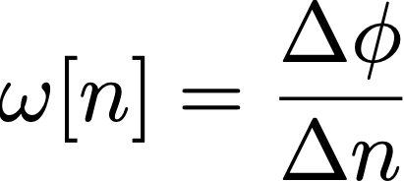

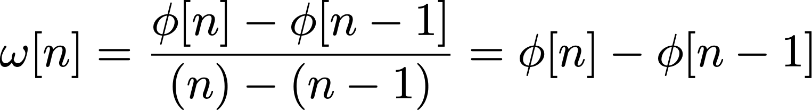
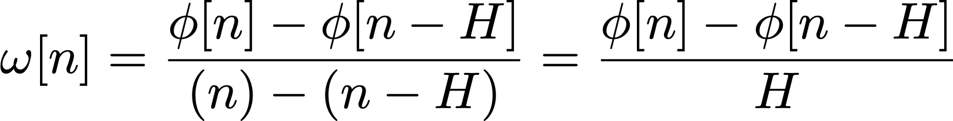
Reconstructing exact frequency
We can estimate the exact frequency of a sine wave from the FFT
Even though the FFT only has bins at fixed, regularly spaced frequencies!
To do this, we will need two hops
Two snapshots of the signal taken a known length of time apart
Key point: frequency is the derivative of phase
or in discrete time:
We can write out the first-order difference:
Or generalising over a hop of H samples:
y

Slide 6
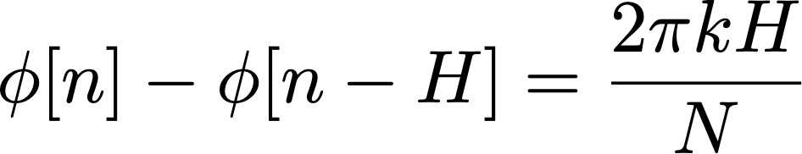
Reconstructing exact frequency
Calculating frequency from phase in discrete time:
In discrete time, frequency 𝜔 is normalised between 0 and 2π;
Assumes unwrapped phase (i.e. always increasing, not constrained 0-2π)
We can invert this formula to calculate phase shift based on frequency:
For a DFT of size N, we know bin k has a frequency of 2πk/N
For a sine wave of exactly the bin frequency, this is the expected phase shift over 1 hop:
By subtracting off this expected phase shift, the remainder will tell us whether the actual frequency is higher or lower than the bin frequency

Slide 7
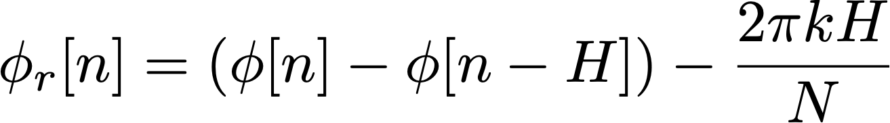
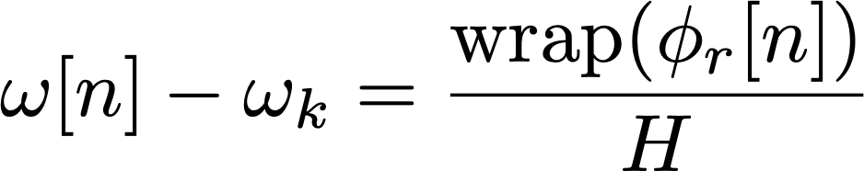
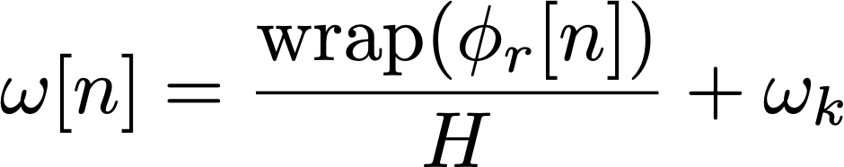
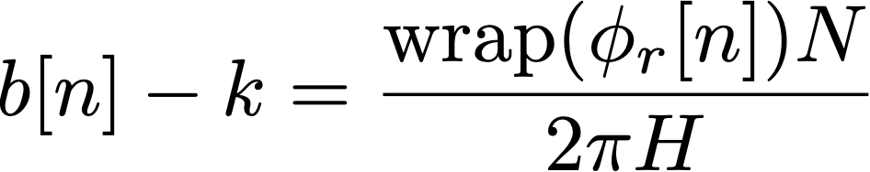
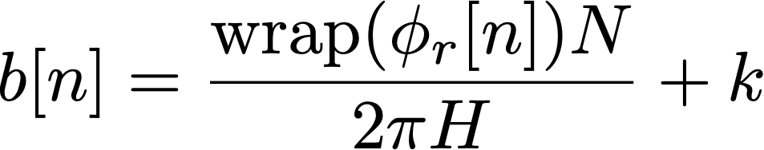
Reconstructing exact frequency
First we calculate the phase remainder:
Then use remainder to calculate the deviation from the bin centre frequency:
We should wrap the phase to be between -π and π (i.e. the principal argument)
Finally, we can rearrange to get the exact frequency of our sine wave:
We could also calculate in terms of (fractional) FFT bins
Use the fact that bins are spaced 2π/N apart in frequency
measured phase values from bin k on two successive hops
centre frequency of bin k
multiplied by the hop size
centre frequency of bin k (= 2πk/N)
fractional bin number
of the sine wave

Slide 8
Reconstructing exact frequency: code
Effectively, we are predicting how far the phase ought to advance from one hop to the next, then comparing the actual measured values
Phase advancing farther means a higher frequency (compared to the bin frequency)
Phase advancing less far means a lower frequency
What do we need to implement this in code?
A global (or static) variable to hold the phase of each bin
Saving each bin implies an array
This is very similar to saving previous values of x[n] or y[n] for a filter (see Lecture 8)
A function to wrap the phase to the range -π to π
Implement the calculations inside of our process_fft() function
Write a for() loop iterating across each bin
y
prediction
ECS7012P Music and Audio Programming • Week 10b

Slide 9
Reconstructing exact frequency: task
Task: in fft-sine, write the code to work out the exact frequency of each bin
Implement these formulas:
Remember you will need a global or static array to hold the previous phases
The GUI will display the frequency of the bin with highest magnitude
However, the same formula can apply to every bin regardless of magnitude
In practice, we only look at the first half of bins because the DFT is conjugate symmetric
hop size
bin phase this hop
bin phase last hop
FFT
size
bin
number
wrapPhase()
written for you
bin centre frequency
(2πk/N)

Slide 10
Choosing an FFT size
The previous formulas gave us one frequency component for each bin
An FFT of size N has (N/2+1) unique bins after accounting for symmetry
This tells us the maximum number of frequency components we can represent
Hence, the larger the FFT, the greater the frequency resolution
Bins are spaced more closely together in frequency: 2πk/N
Easier to resolve two closely-spaced frequency components of a signal
What’s the tradeoff?
N time-domain samples ↔︎ N frequency-domain bins
Resolving short transient events within a long time window is difficult
Frequency-domain processing tends to smear transients, distorting their shape
Another tradeoff to large FFTs: longer latency
These are fundamental mathematical limitations
Poor time resolution

Slide 11
Choosing a hop size
How often should we take an FFT?
Assuming we want to reconstruct signal, hop size H must be no more than FFT size N
Advantages of smaller hop sizes
We get more frequent time snapshots of the signal
Phase of each bin advances less from one hop to next,
improving frequency estimation
Some types of window need a hop size of N/2, N/3 or even less to reconstruct the signal
Lower latency for phase vocoder effects
Disadvantages of smaller hop sizes
More computationally expensive
Hop sizes that aren’t integer division of FFT size can lead to artefacts on reconstruction
H = N
H = N/2
H = N/4

Slide 12
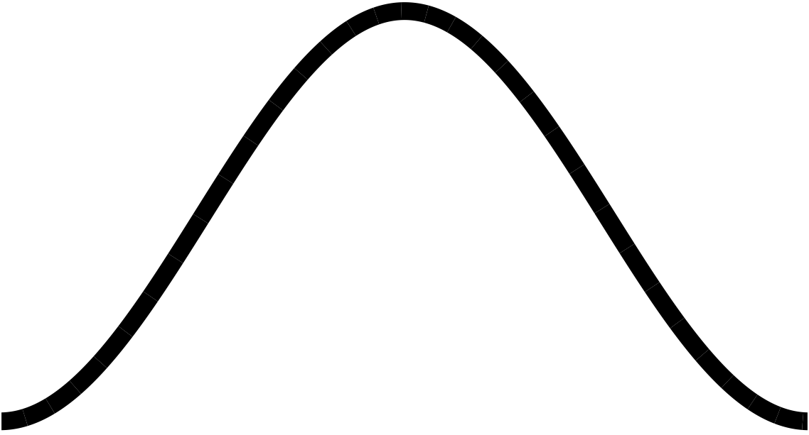
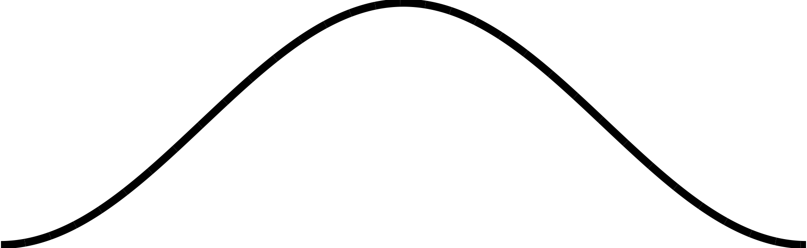
Windowing
Overlap-Add process segments signal into finite-length windows
These segments can have discontinuities at the edges (assuming 0 outside the window)
We might not notice this if we just reconstruct the signal with no frequency-domain processing
If we modify the signal, these sharp edges can lead to crackling or buzzing sounds
We can use a window function to taper the edges
Pre-calculated shape that we multiply the segment by before FFT
H = N/4
sharp edges
Hann window

Slide 13
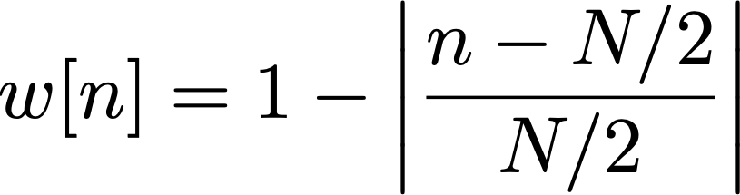


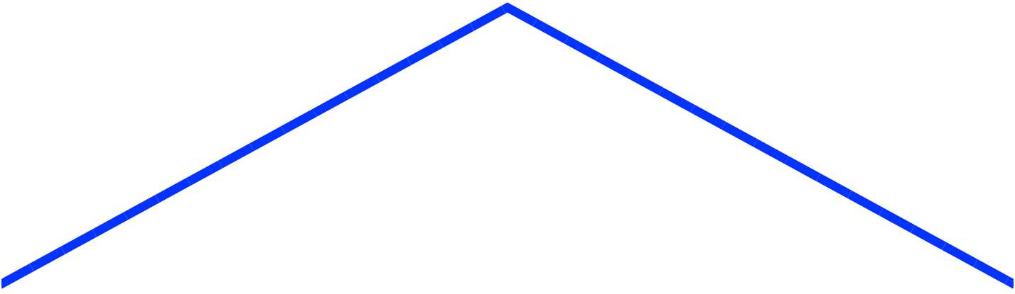
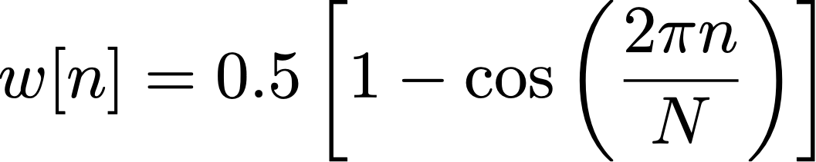
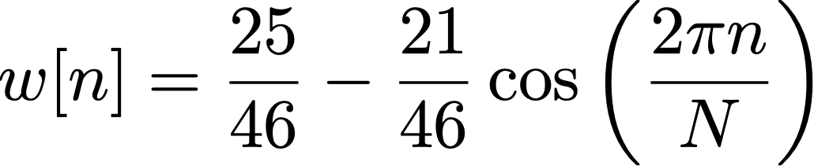
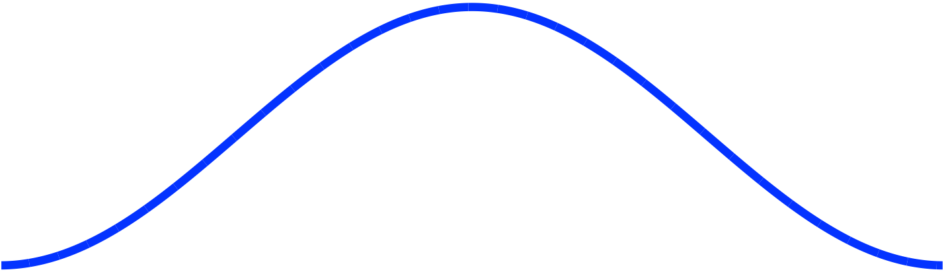
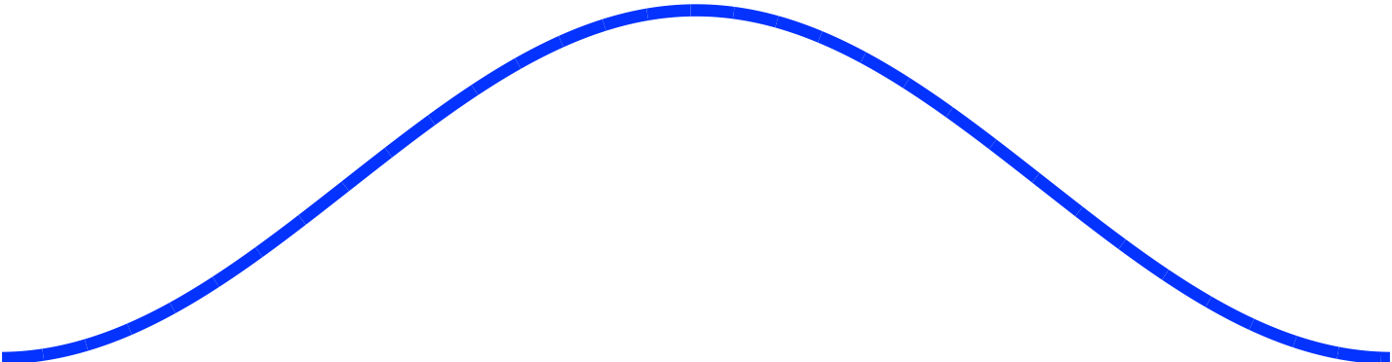
Types of window function
Rectangular
Triangular (Bartlett)
for
Hann
Hamming

Slide 14
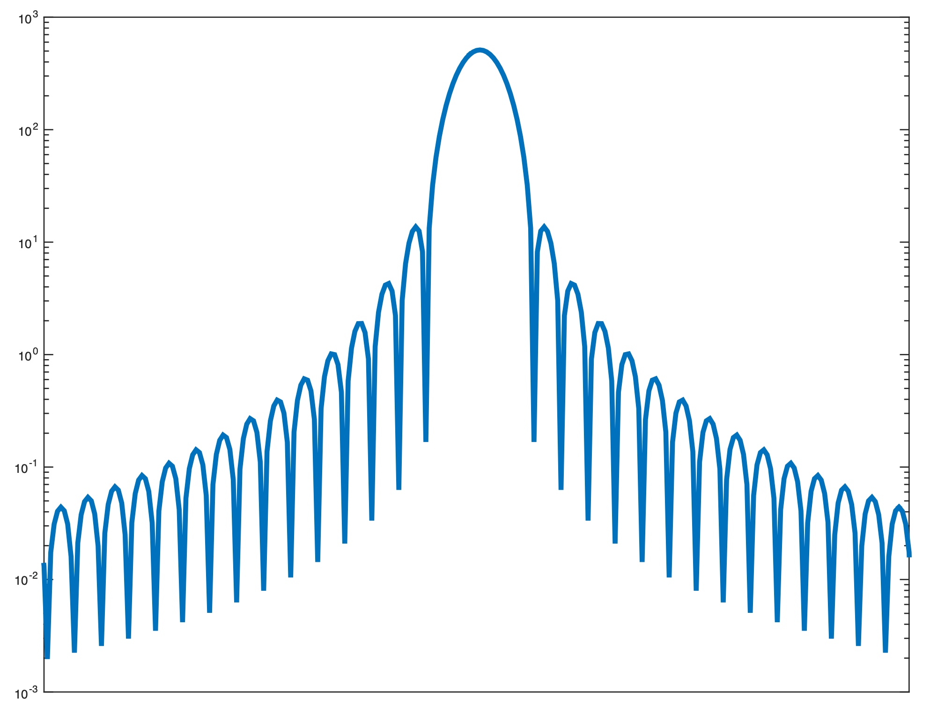
Effects of windowing
Windowing lets us isolate a particular time segment of our signal
The cost is smearing of energy in the frequency domain
Energy appears at frequencies where it doesn’t exist in the original signal
Each frequency component of the signal appears as a series of lobes
Main lobe: a broad peak centred around the actual frequency
Side lobes: secondary peaks at other frequencies
We typically want to minimise:
Main lobe width
Side lobe height
Side lobe height
(expressed in dB)
Main lobe width
(expressed in
frequency)
Hann-windowed
spectrum
(frequency smearing)
ideal signal
(all energy at one
frequency)
ECS7012P Music and Audio Programming • Week 10b

Slide 15
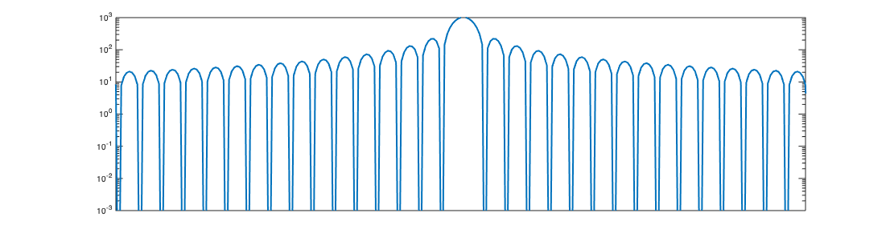
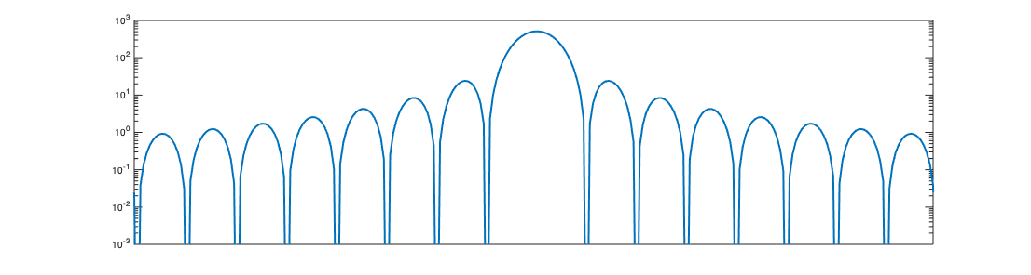
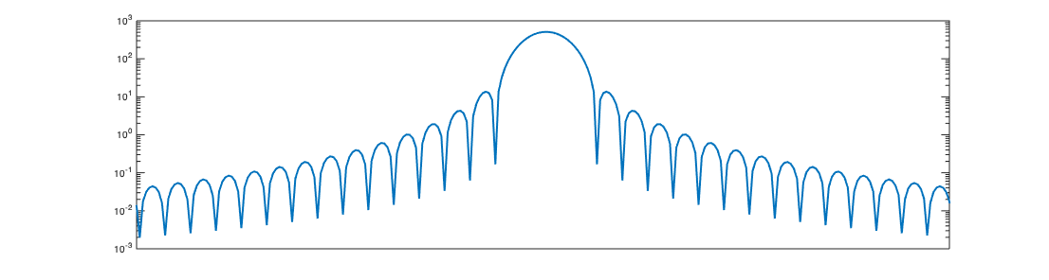
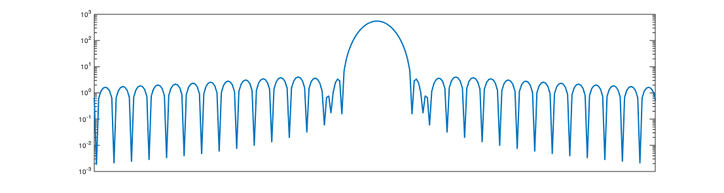
Window spectra
Rectangular
Triangular (Bartlett)
Main lobe width: 4π/N
Side lobe height: -13dB
Main lobe width: 8π/N
Side lobe height: -26.5dB
Hann
Hamming
Main lobe width: 8π/N
Side lobe height: -31.5dB
Main lobe width: 8π/N
Side lobe height: -42.8dB
→ When in doubt: use a Hann window
ECS7012P Music and Audio Programming • Week 10b

Slide 16
Coding a window
It is most efficient to pre-calculate the window when the program starts
Then recalculate when settings change: window size, window type etc.
Store the window in an array (typically a global variable)
Length of the array is equal to the window size
To calculate, use a for() loop to iterate over each sample of the window
To apply, multiply the signal by the window buffer frame-by-frame
Could do this while unwrapping a circular buffer (see Lecture 18)
const int windowSize = 1024;
float windowBuffer[gWindowSize];
for(unsigned int n = 0; n < windowSize; n++) {
windowBuffer[n] =
}
equation for window
for(unsigned int n = 0; n < windowSize; n++) {
windowedSignal[n] = originalSignal[n] * windowBuffer[n];
}
ECS7012P Music and Audio Programming • Week 10b

Slide 17
Visualising the effects of windowing
Let’s go back to our fft-sine project and see the window in action
Task: in fft-sine, implement a Hann window
Change the frequency in the GUI so it doesn’t align with any bin
What happens to the width of the main lobe?
What happens to the side lobes?
As a bonus, the Hann window should improve the frequency estimation!
Why didn’t we see the classic comb filter pattern?
Because the window size is the same as the FFT size
The FFT is effectively sampling the peaks of each lobe
Task 2: in setup(), change the window size to be a fraction of the FFT length
Say 1/4 or 1/8 of the FFT length
Now the lobes should be visible

